Slide 1
ALIMENTAZIONE E NUTRACEUTICI PER IL PAZIENTE CON MASLD
GIOVANNI DE PERGOLA
Centro di Nutrizione Clinica per la Ricerca e Cura della Obesità, IRCCS de Bellis, Castellana Grotte(Bari)

Slide 2
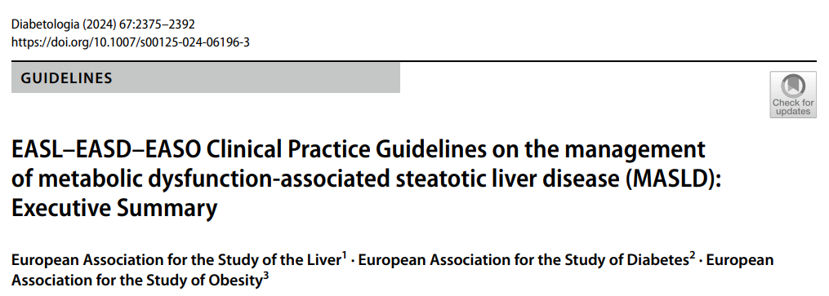
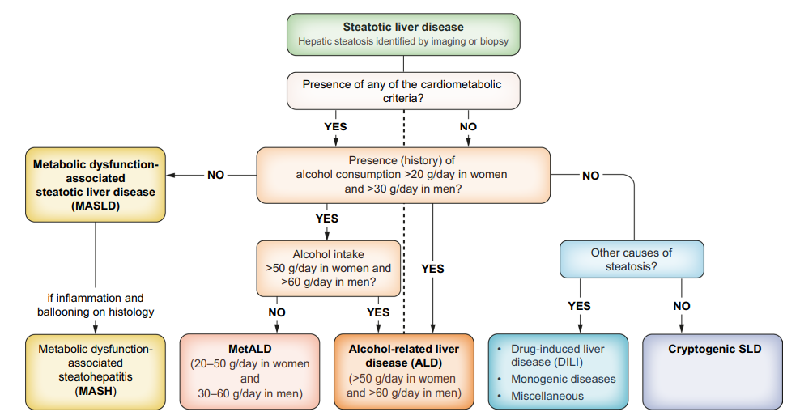

Slide 3
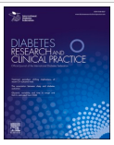
We analyzed data from 164 participants with overweight or obesity (41.4 % male), including 39 individuals (23.8 %) with type 2 diabetes
Liver steatosis was significantly more prevalent in individuals with diabetes (89.7 % vs 52 %, P < 0.001). Liver fibrosis was observed in 35.9 % of subjects with diabetes (vs 13.6 %, P = 0.002).
Significant associations between CAP (MD: 30.87, P = 0.009) and liver stiffness (MD: 2.454, P = 0.006) with diabetes were found, independent of other variables.
2024
2024

Slide 4
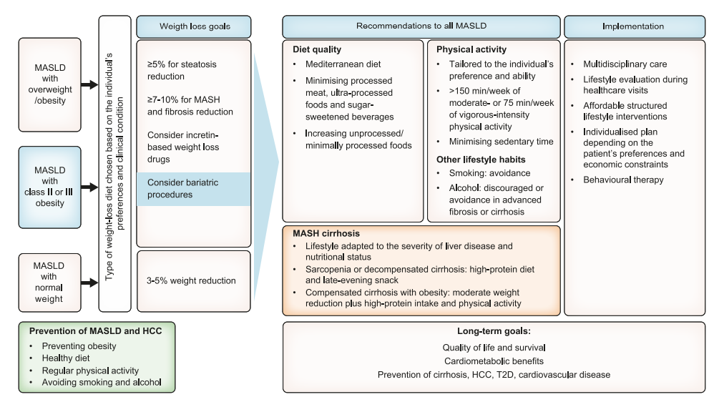
Obesity Facts, 2024

Slide 5
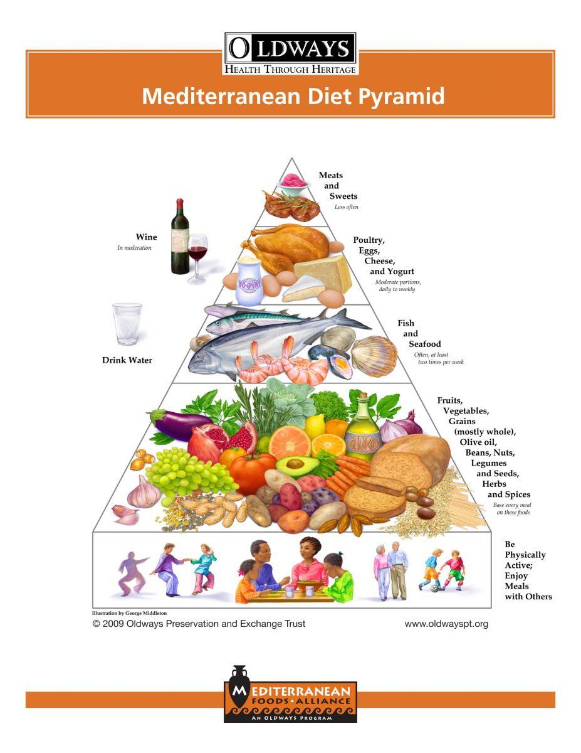
PIRAMIDE DELLA DIETA MEDITERRANEA
Meno frequentemente
Porzioni moderate, da giornalmente
a settimanalmente
Almeno 2 volte per settimana
Ogni pasto

Slide 6
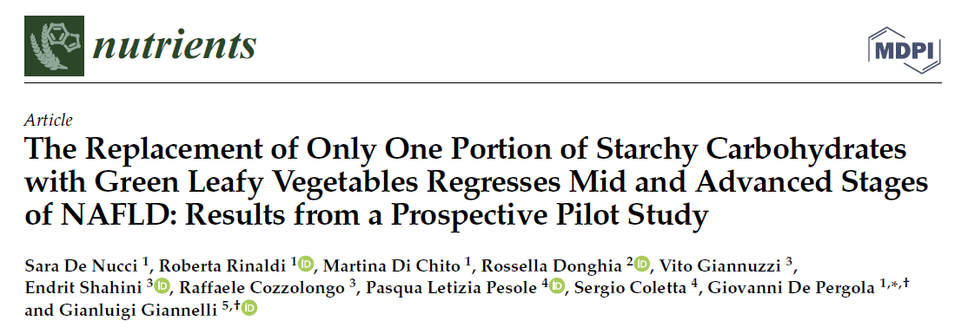
2023

Slide 7
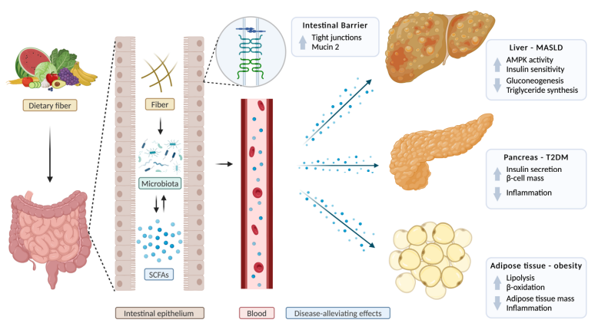
Biomolecules, 2025

Slide 8
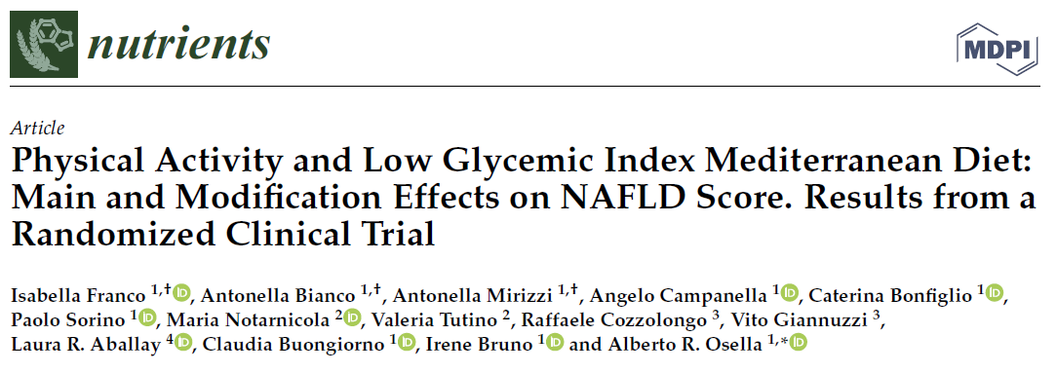
2021

Slide 9
On multivariable logistic regression analysis
adjusting for potential confounders and dietary patterns, nut consumption > 1time/day was inversely associated with NAFLD in the overall cohort (adjusted Odds ratio[aOR]: 0.719 [95%CI:0.558–0.926], p = 0.011).
2020

Slide 10
Obesity Facts, 2024

Slide 11
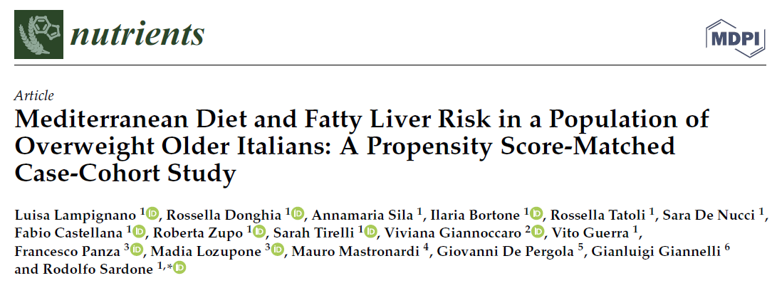
2022

Slide 12
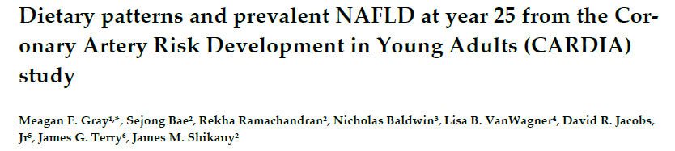
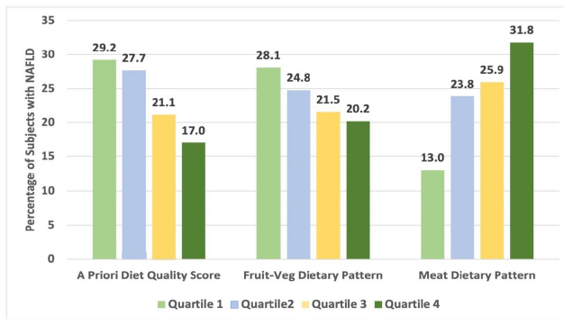
Nutrients, 2022

Slide 13
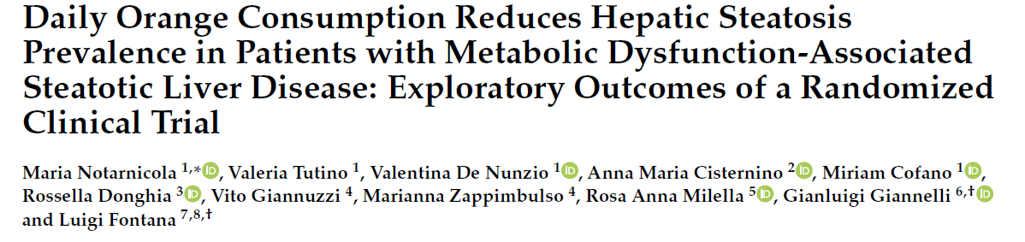
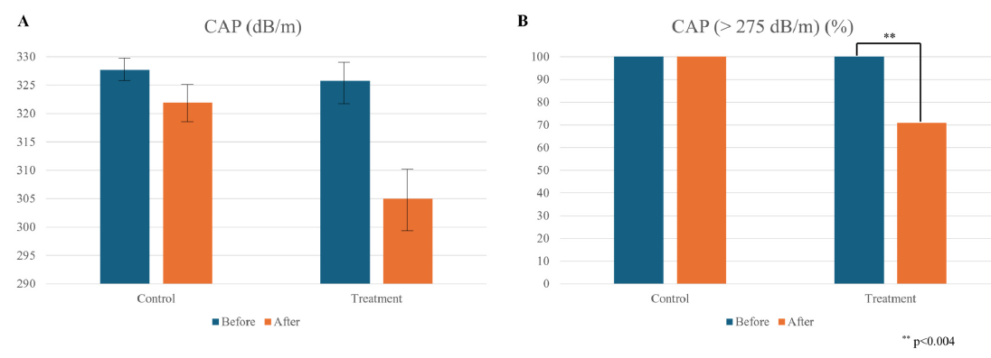
Phytochemical-rich foods, especially whole fruits like oranges, may enhance liver function as an adjunct treatment for MASLD. The notable reduction in liver steatosis prevalence occurred independently of body weight changes.
Nutrients, 2024

Slide 14
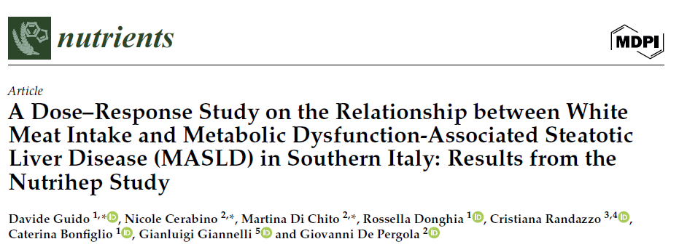
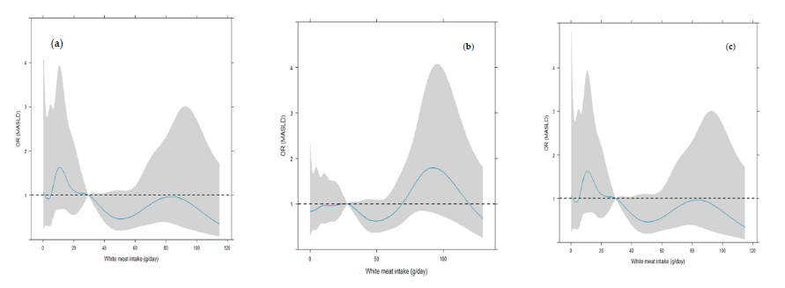
Our data suggest that white meat does not have a clear-cut independent dose–response effect on MASLD, but sex may be a trigger moderator for age and BMI, with an increasing unfavorable effect of white meat in women, and a favorable effect in men.
2024

Slide 15
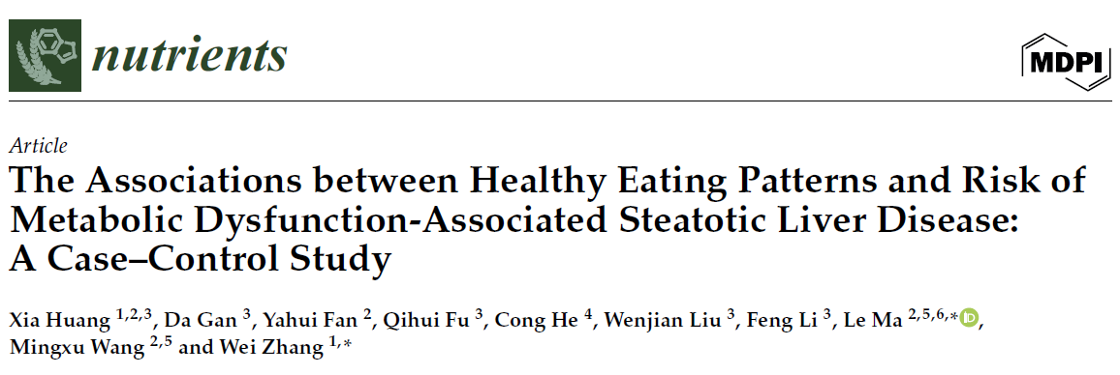
Greater adherence to healthy eating patterns was associated with reduced risk of MASLD, with vegetables and whole grains predominately contributing to these associations
Nutrients, 2024

Slide 16
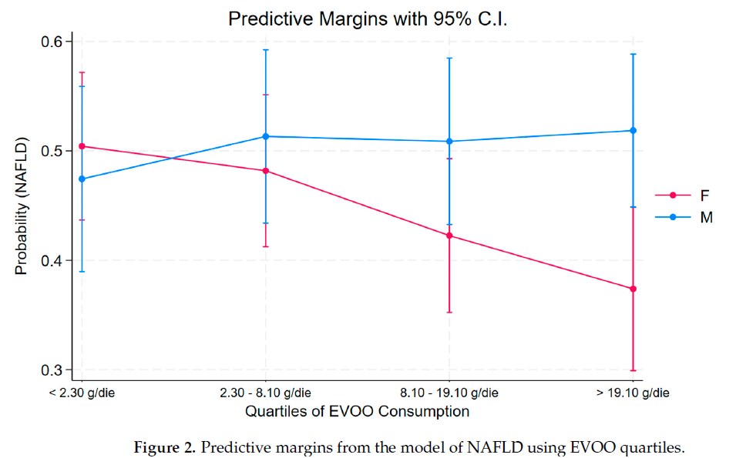
2024

Slide 17
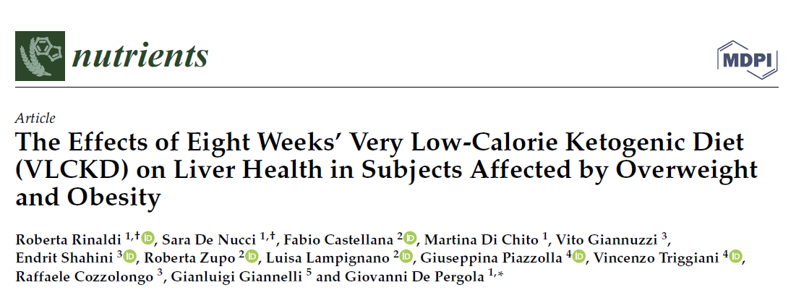
2023

Slide 18
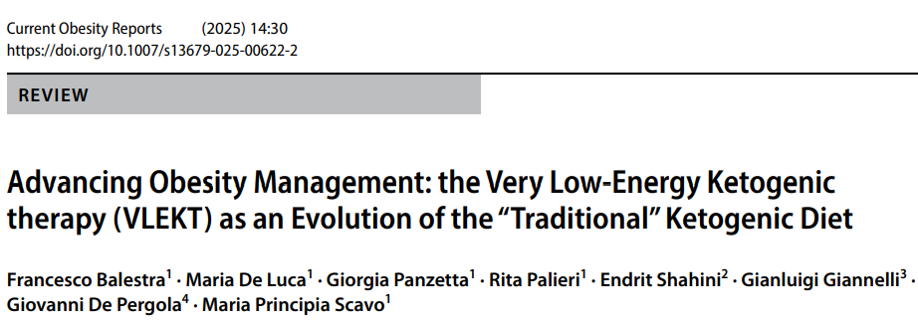
2025

Slide 19
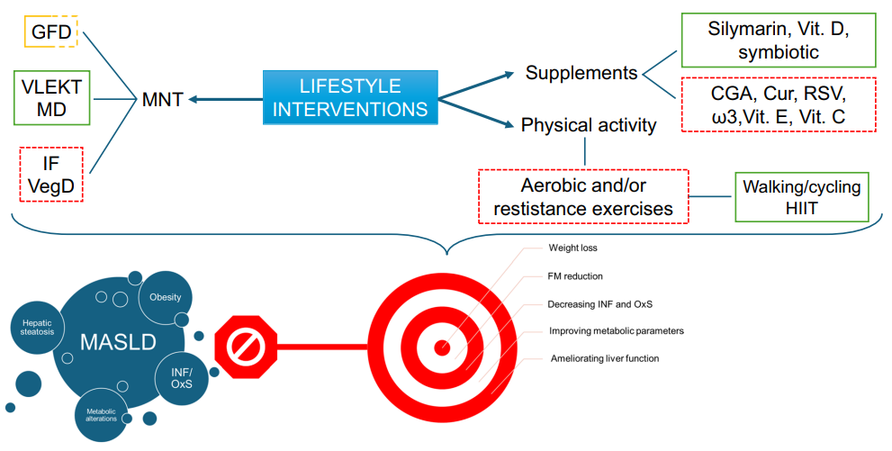
Abbreviations: GFD, gluten-free diet; VLEKT, very lowenergy ketogenic therapy; MD, Mediterranean Diet; IF, intermittent fasting; VegD, vegetarian diet; MNT, medical nutrition therapy; Vit D-E-C, Vitamins D, E, and C; CGA, chlorogenic acid; Cur, curcumin; RSV, resveratrol; HIIT, high-intensity interval training; INF, infammation; OxS, oxidative stress; MASLD, metabolic-associated steatotic liver disease
2025

Slide 20
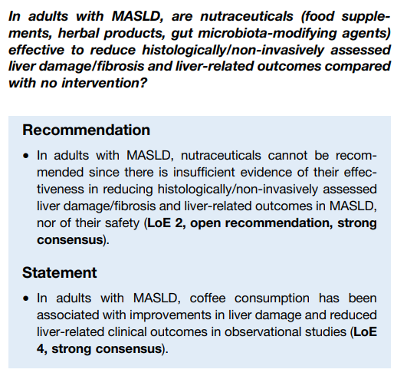
2024

Slide 21
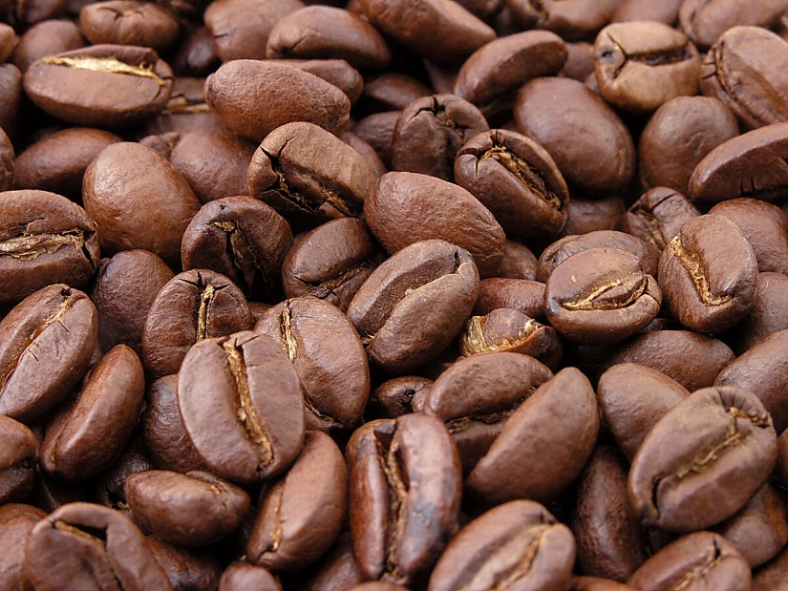
2024

Slide 22
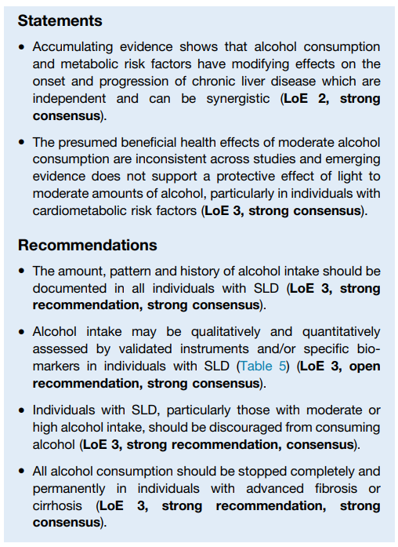
2024

Slide 23
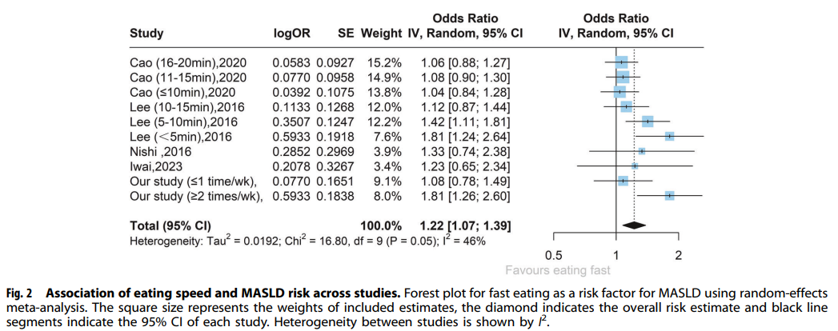
Nutrition & Diabetes, 2024

Slide 24
Grazie

